Slide 1
Progress Update
February 21, 2021
David Chen

Slide 2
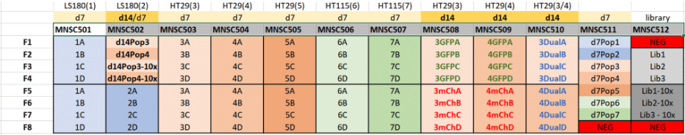
Cell Line Nomenclature for reference
S1
S2
S3
S4
S5
S6
S7
S8
S9
S10
Replicate A
Replicate B
For example, Cell Line 5B refers to:

Slide 3
S1 vs. S2

Slide 4
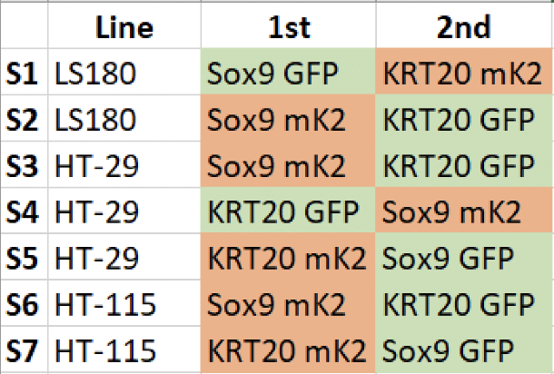
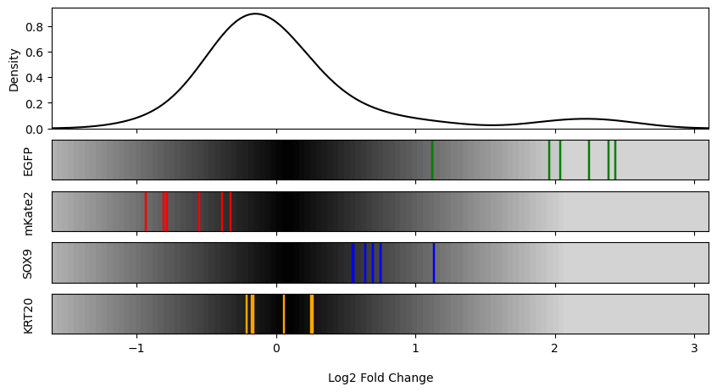
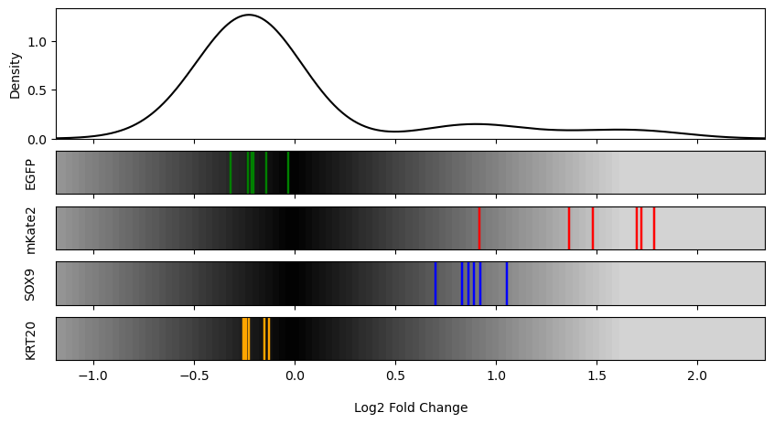
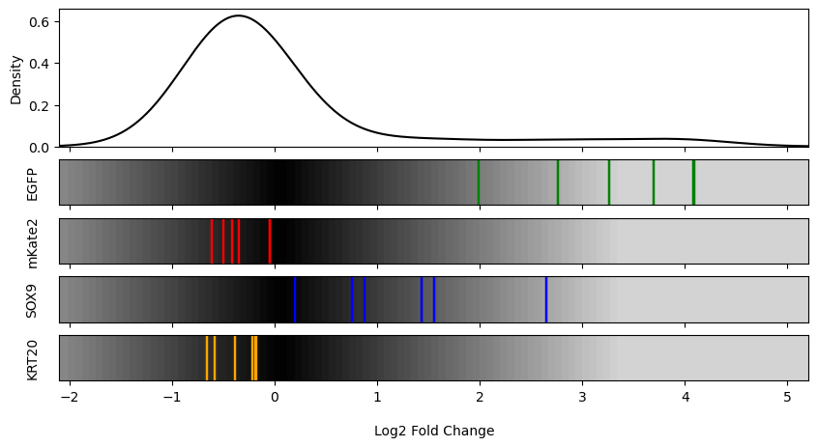
S1 vs. S2: GFP(A) | mCherry (B)
S1
S2
A
B

Slide 5

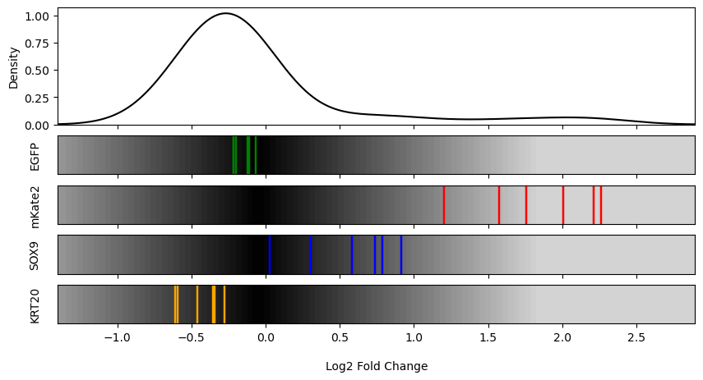
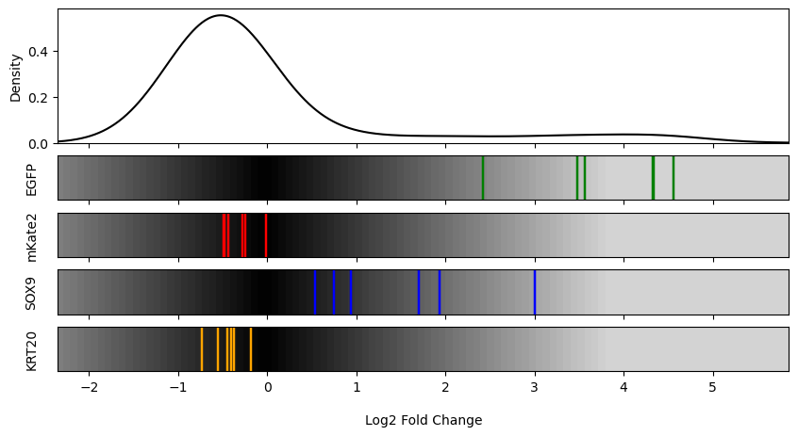
S1 vs. S2: GFP(A) | Negative(C)
S1
S2
A
B

Slide 6
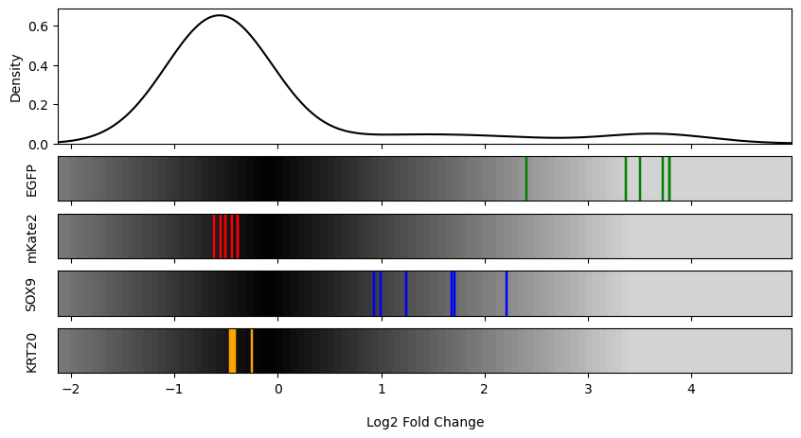

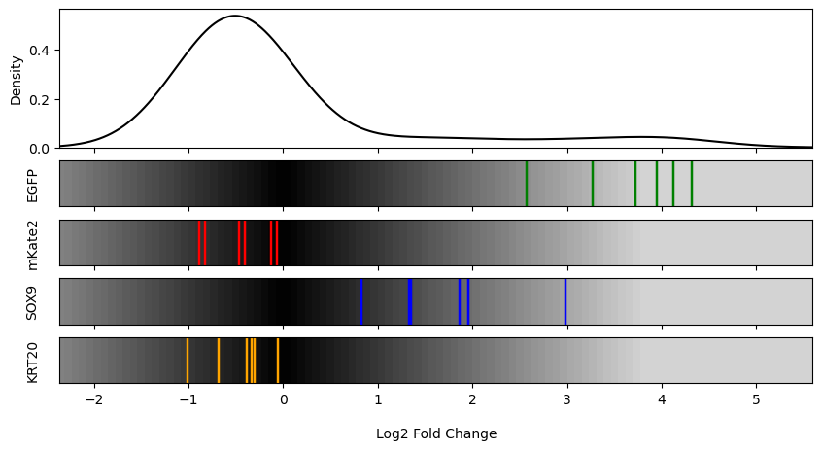
S1 vs. S2: GFP(A) | Negative(D)
S1
S2
A
B

Slide 7
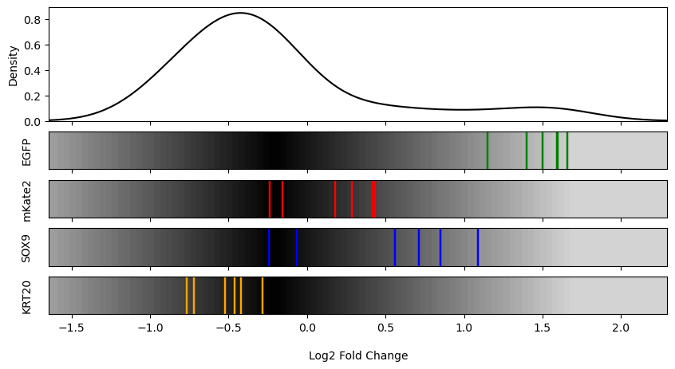
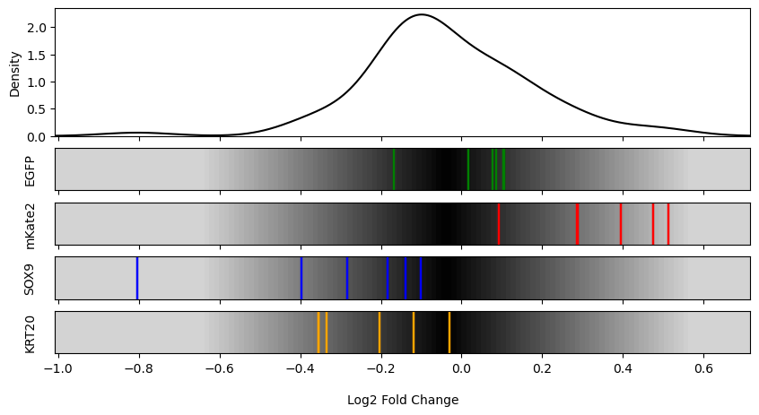
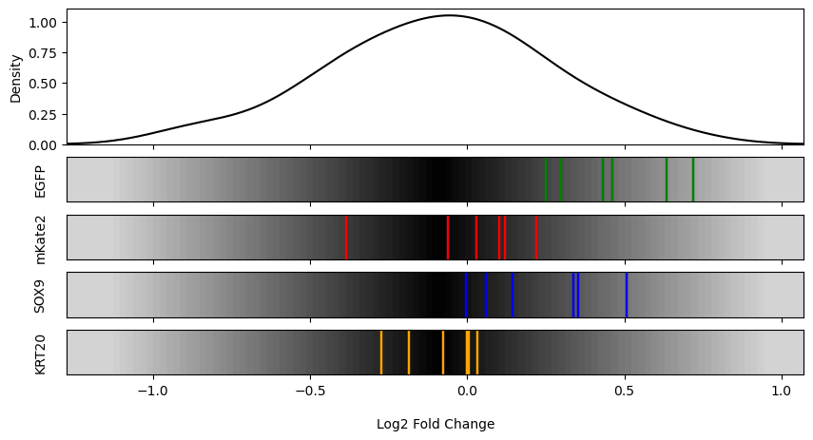
S1 vs. S2: mCherry (B) | Negative(C)
S1
S2
A
B

Slide 8
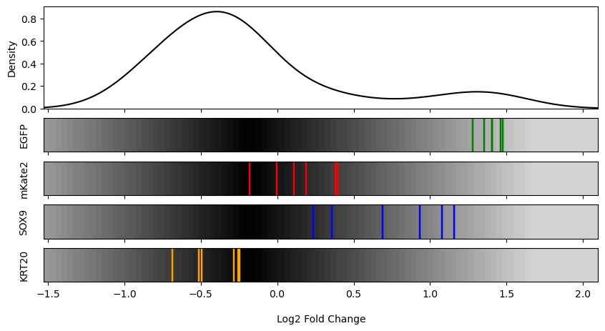
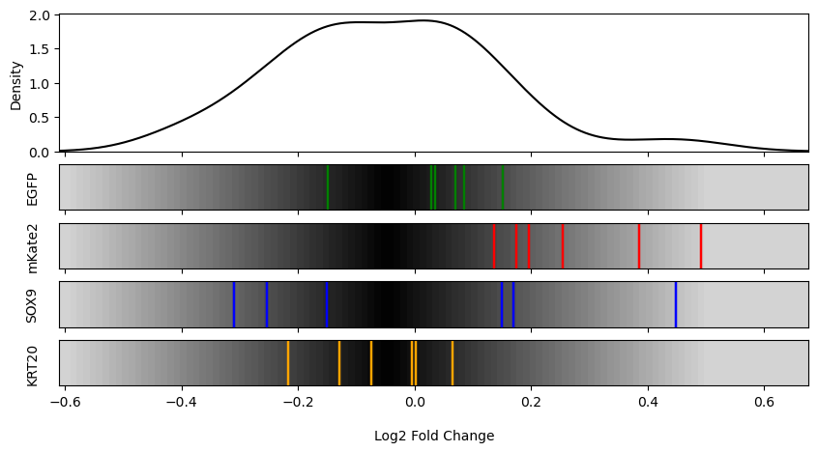
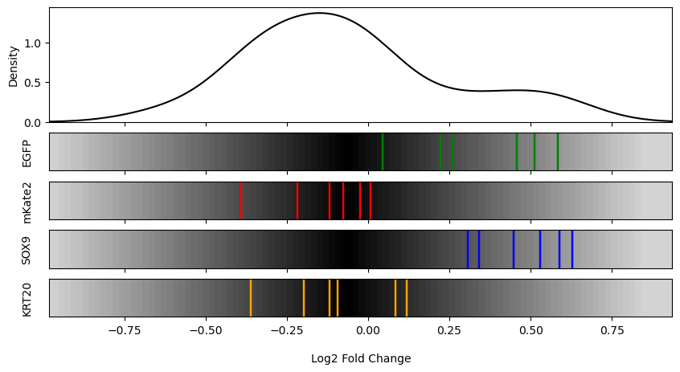
S1 vs. S2: mCherry (B) | Negative(D)
S1
S2
A
B

Slide 9
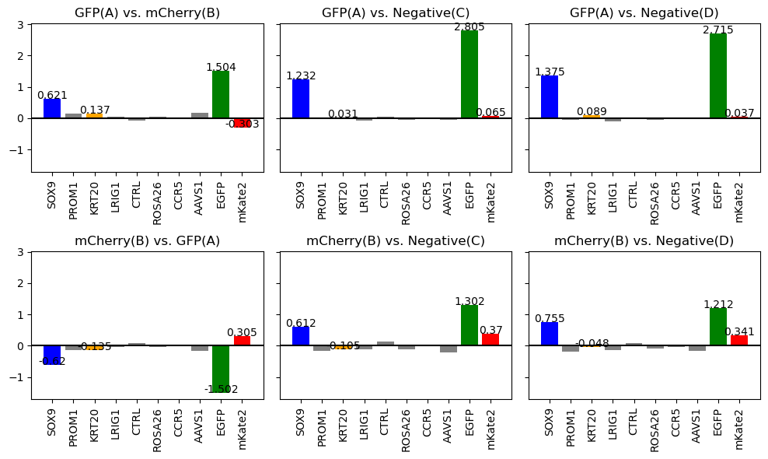
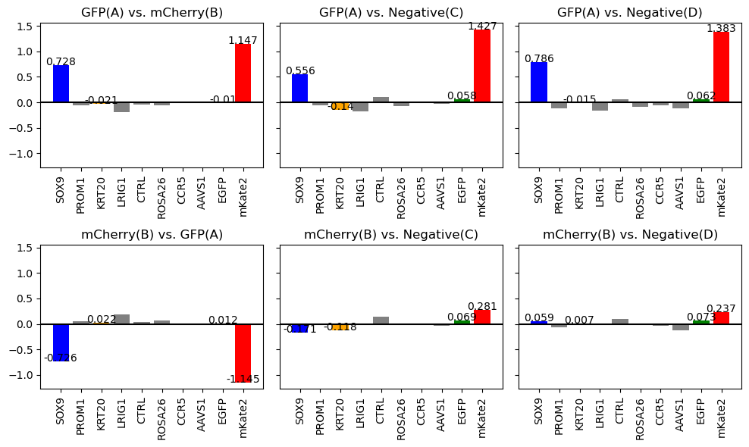
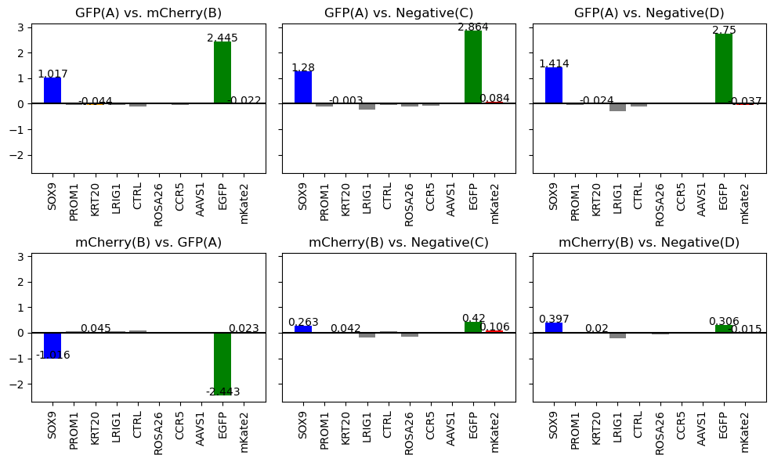
S1 vs. S2 Beta Score
S1
S2
A
B

Slide 10
S3 vs. S4 vs. S5

Slide 11
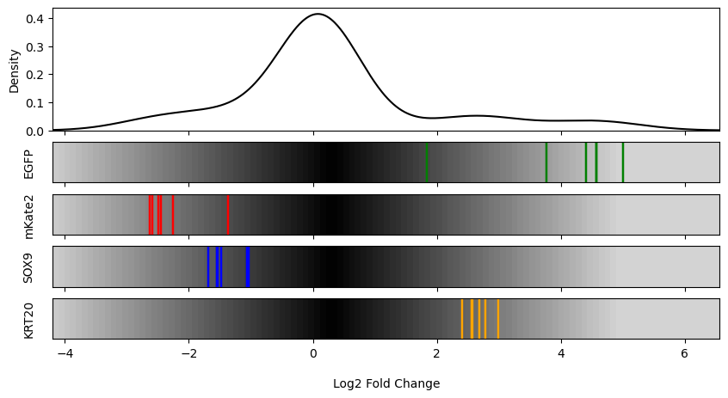
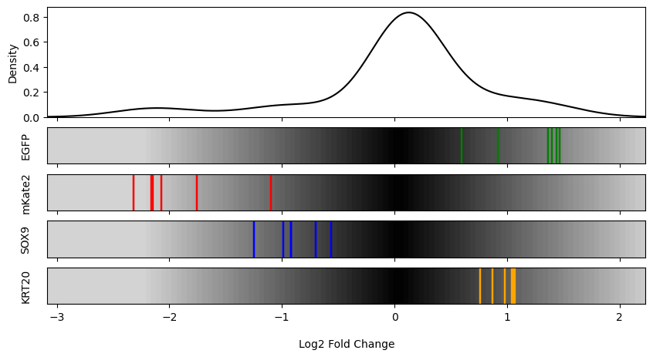
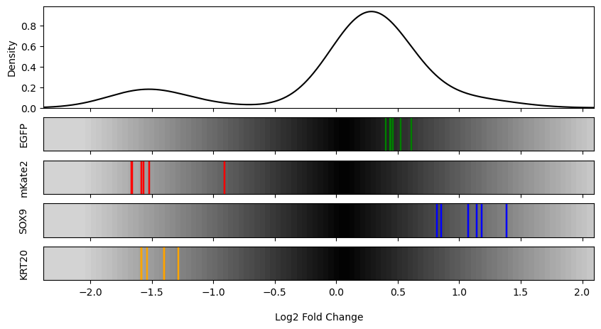
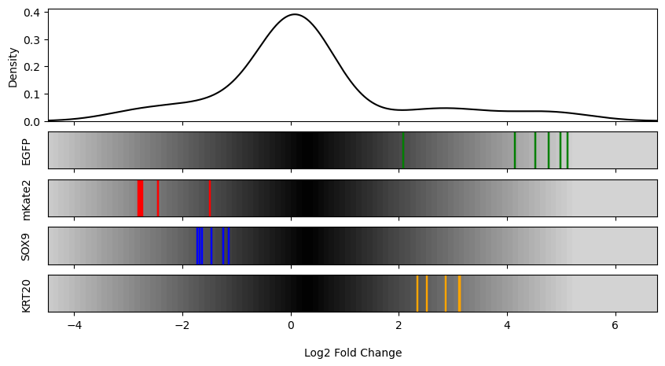
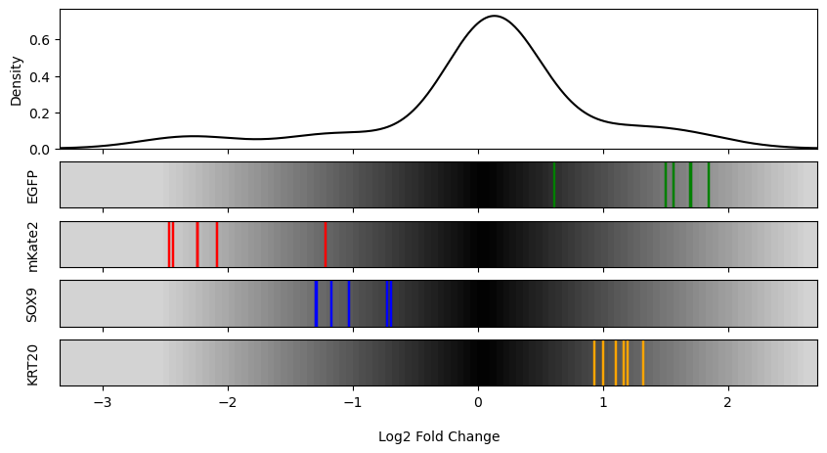
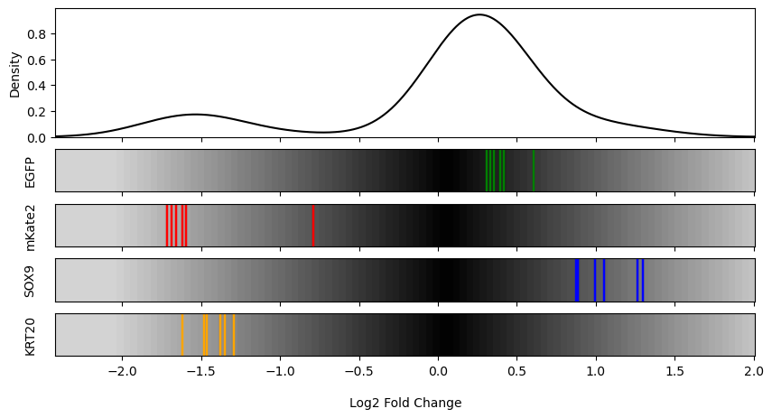
S3 vs. S4 vs. S5: GFP(A) | mCherry (B)
S3
S4
S5
A
B

Slide 12
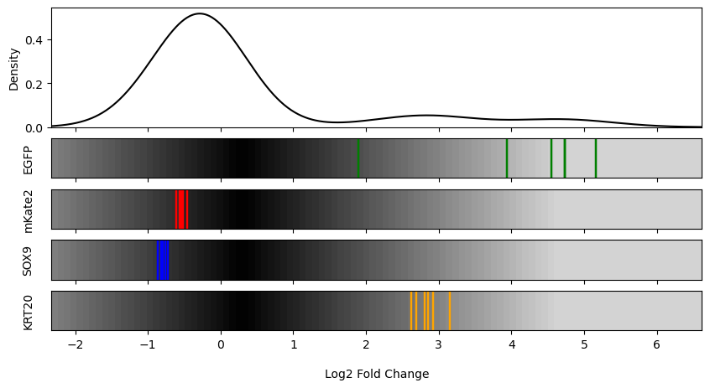
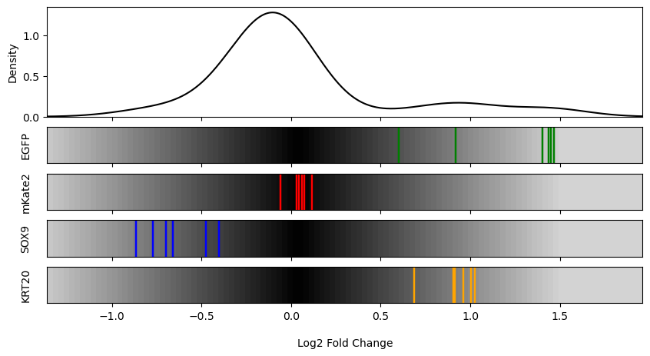
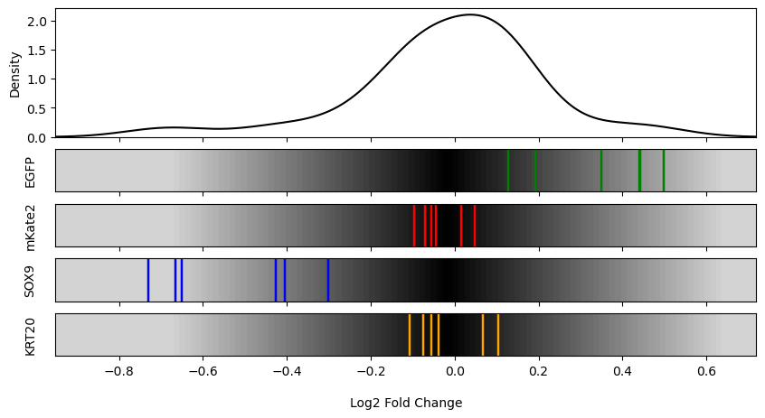

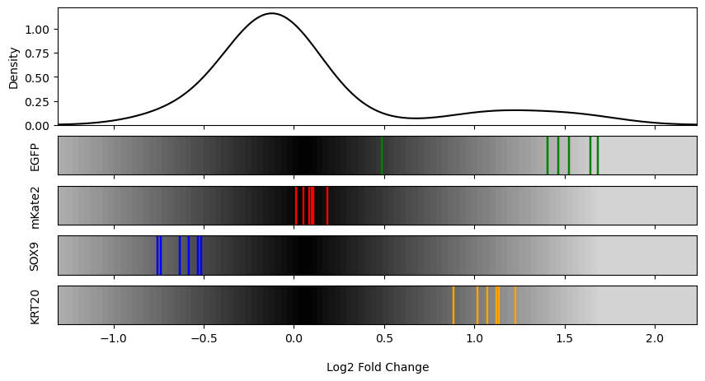
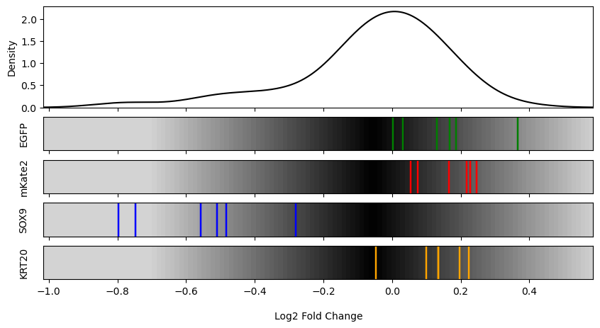
S3 vs. S4 vs. S5: GFP(A) | Negative (C)
S3
S4
S5
A
B

Slide 13
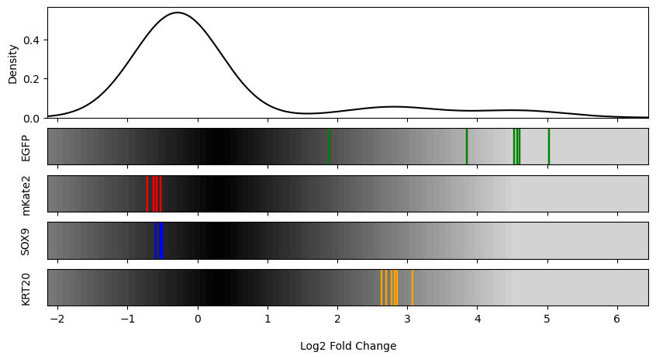
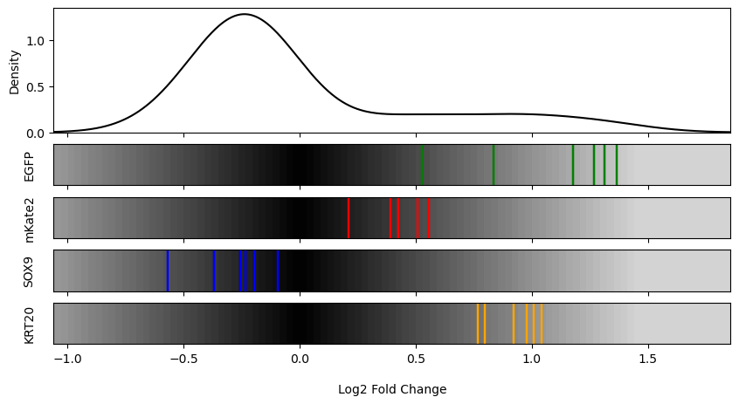
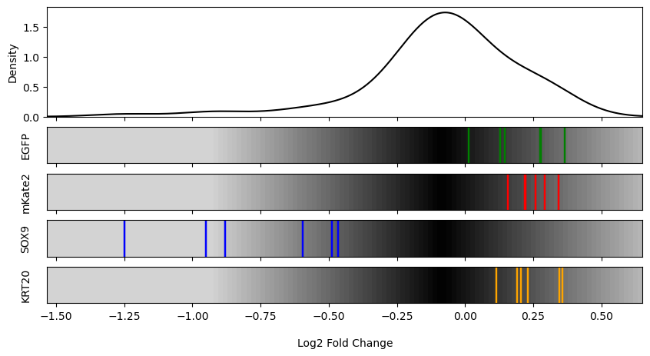
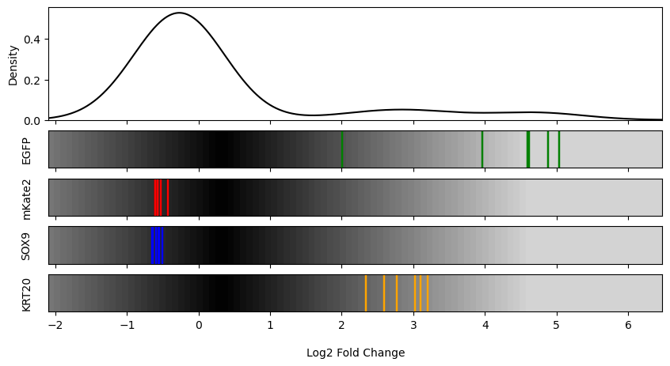
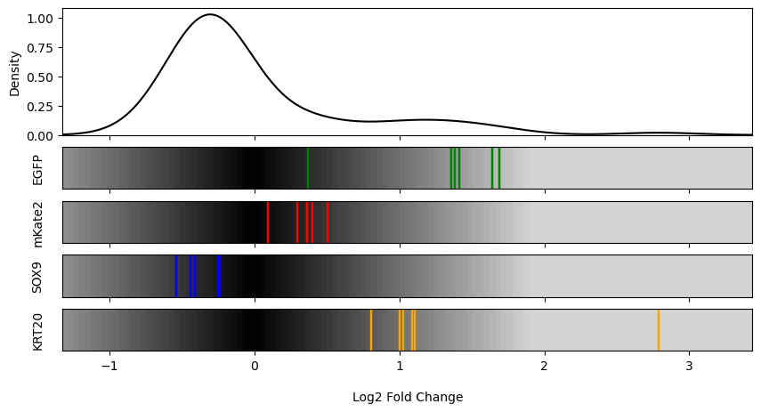
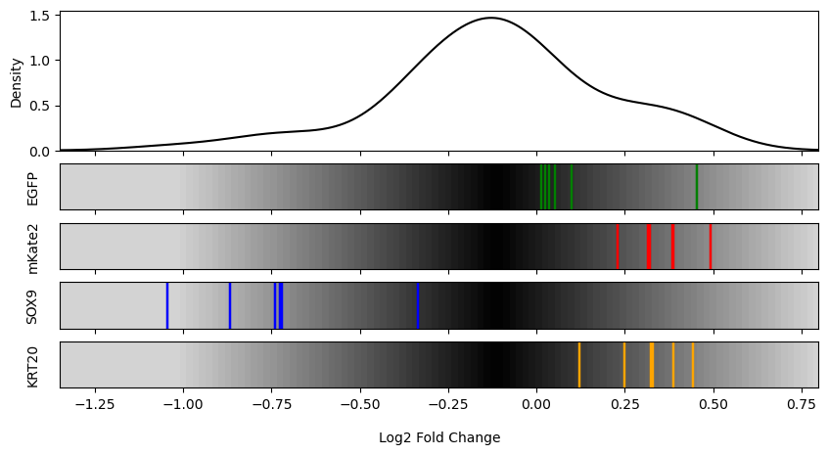
S3 vs. S4 vs. S5: GFP(A) | Negative (D)
S3
S4
S5
A
B

Slide 14
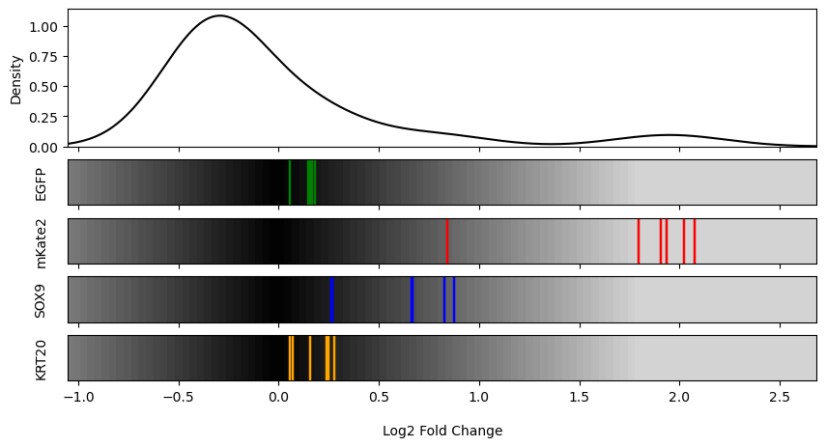
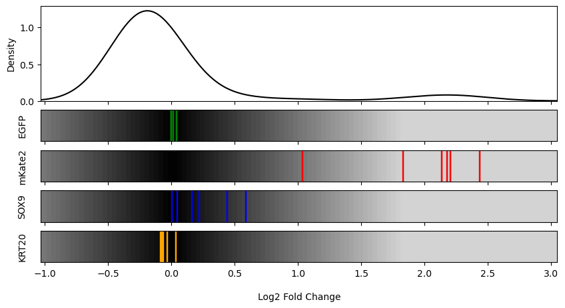
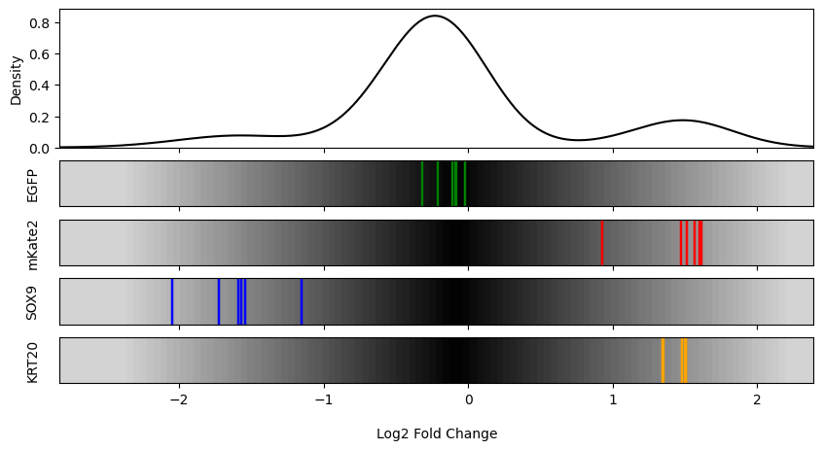
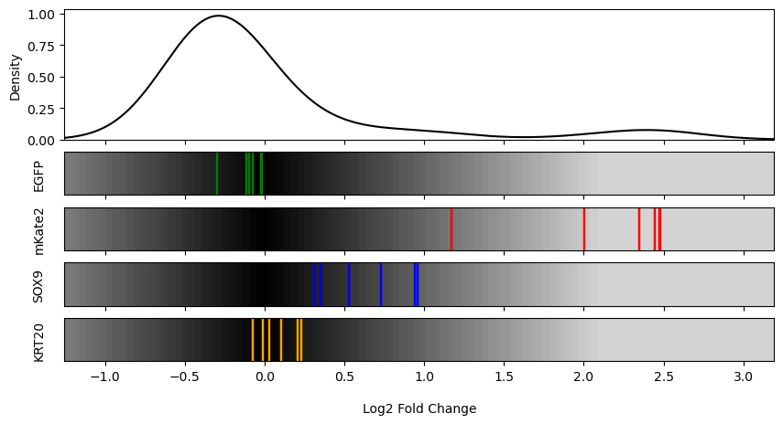
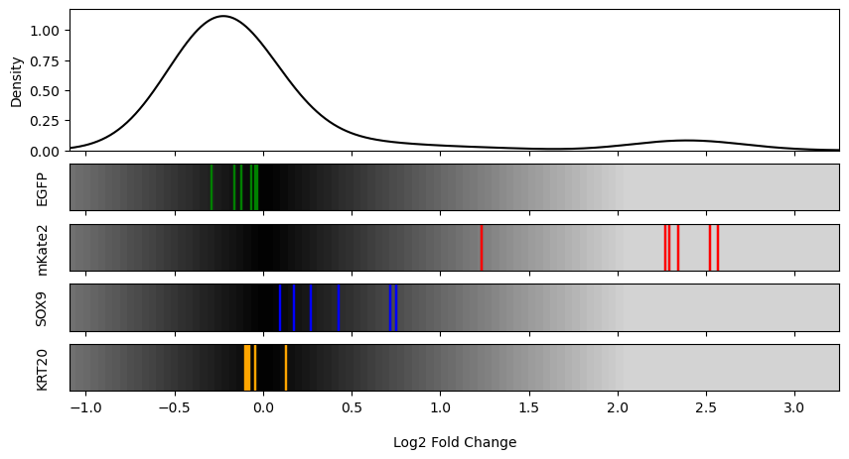
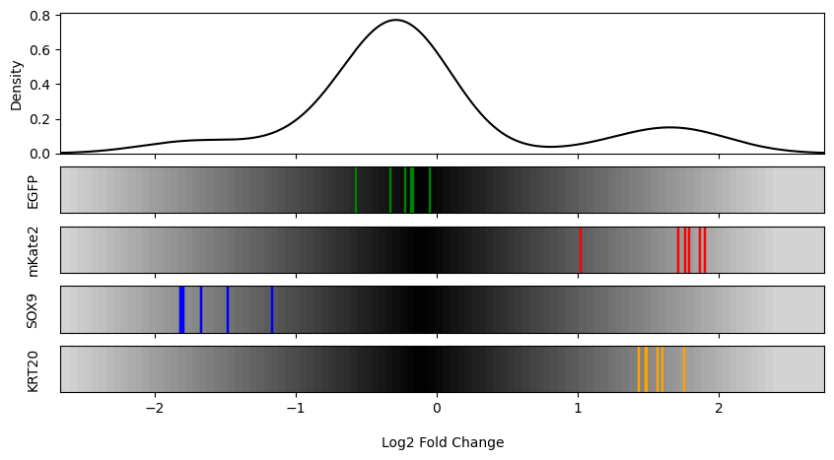
S3 vs. S4 vs. S5: mCherry (B) | Negative (C)
S3
S4
S5
A
B

Slide 15
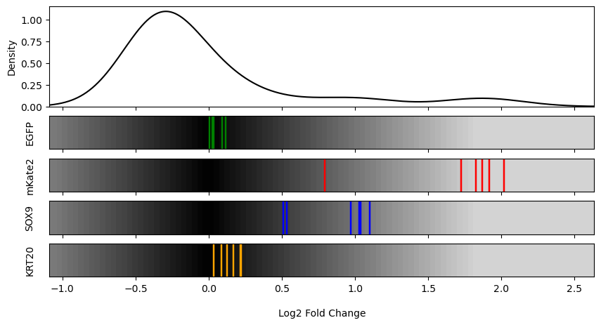
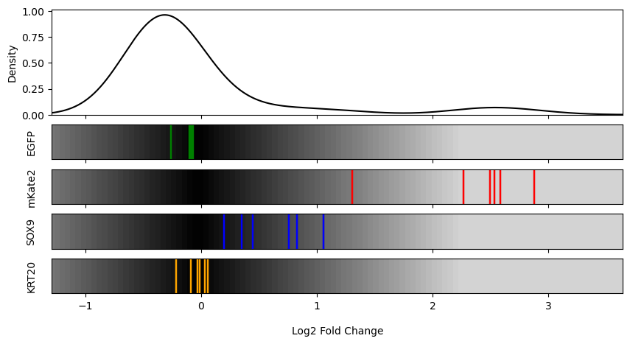
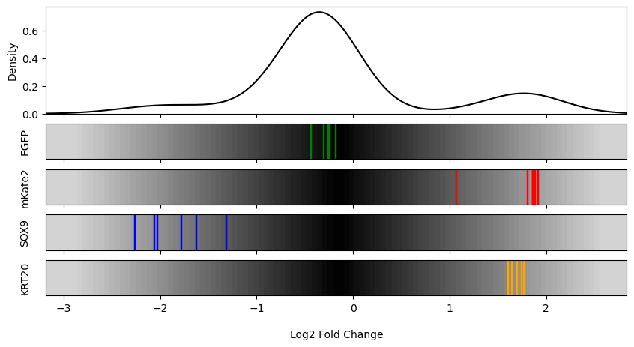
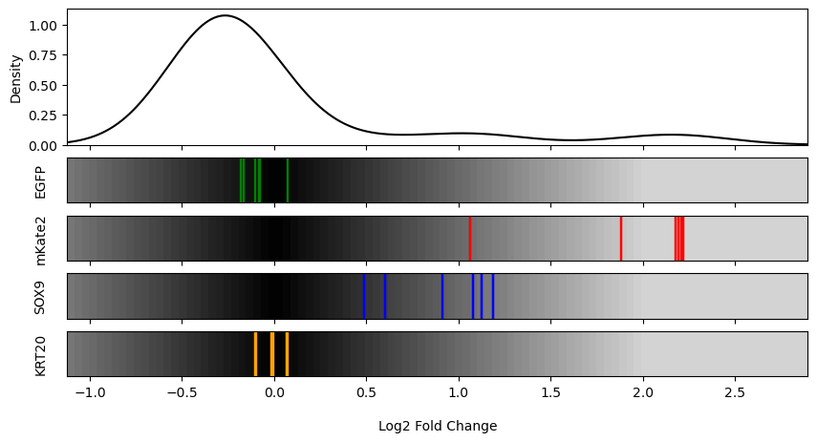

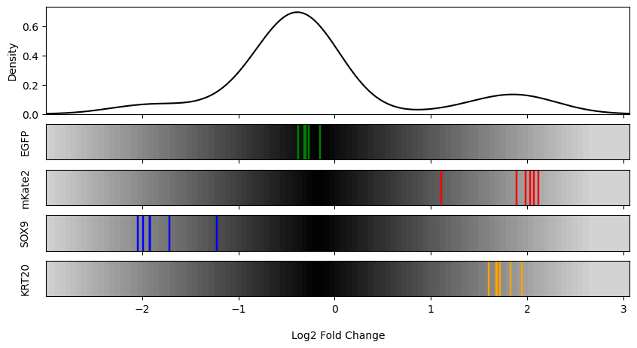
S3 vs. S4 vs. S5: mCherry (B) | Negative (D)
S3
S4
S5
A
B

Slide 16
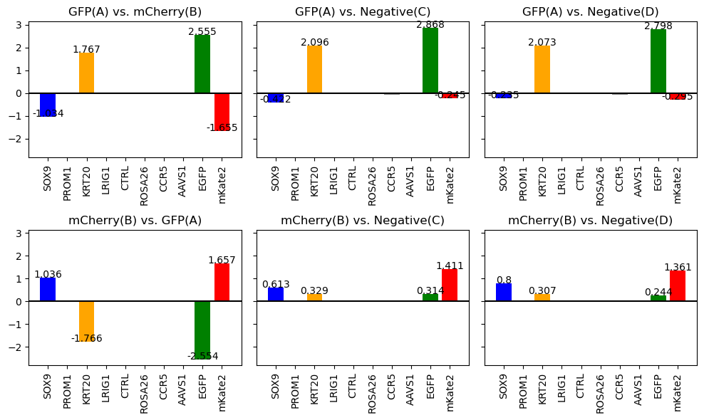
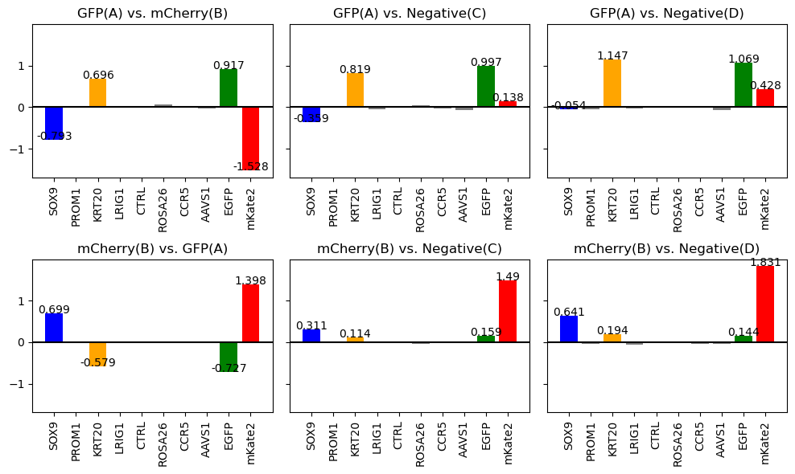
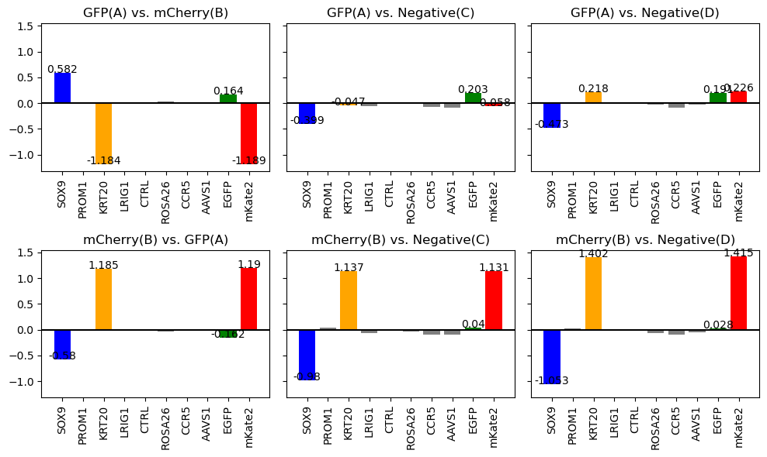
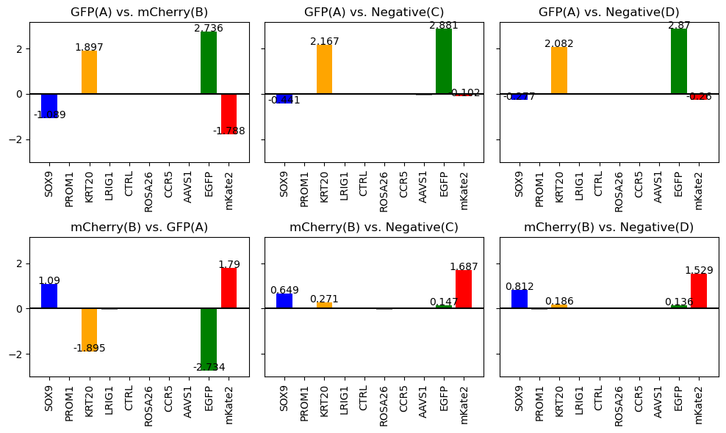


S3 vs. S4 vs. S5 Beta Score
S3
S4
S5
A
B

Slide 17
S6 vs. S7

Slide 18




S6 vs. S7: GFP(A) | mCherry (B)
S6
S7
A
B

Slide 19




S6 vs. S7: GFP(A) | Negative (C)
S6
S7
A
B

Slide 20




S6 vs. S7: GFP(A) | Negative (D)
S6
S7
A
B

Slide 21




S6 vs. S7: mCherry (B) | Negative (C)
S6
S7
A
B

Slide 22




S6 vs. S7: mCherry (B) | Negative (D)
S6
S7
A
B

Slide 23




S6 vs. S7 Beta Score
S6
S7
A
B

Slide 24
S8 vs. S10A

Slide 25







Dual Reporter HT29(3) vs Single Channel HT29(3) mCherry vs Single Channel HT29(3) GFP (S8 vs. S10A)
GFP_A vs. mCherry_B
GFP_A vs. Negative_C
GFP_A vs. Negative_D
mCherry_B vs. Negative_C
mCherry_B vs. Negative_D
mCherry Top 5% vs Bottom 5%
GFP Top 5% vs Bottom 5%

Slide 26



Dual Reporter HT29(3) vs Single Channel HT29(3) mCherry vs Single Channel HT29(3) GFP (S8 vs. S10A) Beta Score
Dual Reporter
Single Channel GFP
Single Channel mCherry

Slide 27
S9 vs. S10B

Slide 28







Dual Reporter HT29(4) vs Single Channel HT29(4) mCherry vs Single Channel HT29(4) GFP (S9 vs. S10B)
GFP_A vs. mCherry_B
GFP_A vs. Negative_C
GFP_A vs. Negative_D
mCherry_B vs. Negative_C
mCherry_B vs. Negative_D
mCherry Top 5% (A) vs Bottom 5% (B)
GFP Top 5% (A) vs Bottom 5% (B)

Slide 29



Dual Reporter HT29(4) vs Single Channel HT29(4) mCherry vs Single Channel HT29(4) GFP (S9 vs. S10B)
Dual Reporter
Single Channel GFP
Single Channel mCherry

Slide 30
S3 vs. S8

Slide 31


S3 vs. S8: GFP(A) | mCherry (B)
S3
S8
A
B

Slide 32


S3 vs. S8: GFP(A) | Negative(C)
S3
S8
A
B

Slide 33
S3 vs. S8: GFP(A) | Negative(D)
S3
S8
A
B

Slide 34

S3 vs. S8: mCherry (B) | Negative(C)
S3
S8
A
B

Slide 35


S3 vs. S8: mCherry (B) | Negative(D)
S3
S8
A
B

Slide 36
S3 vs. S8 Beta Score
S3
S8
A
B

Slide 37
S3 (day 3) vs. S10A (day 7)

Slide 38
S3 vs. S10A: GFP(A) | mCherry (B)
S3
S10
A
B

Slide 39
S3 vs. S10A: GFP(A) | Negative(C)
S3
S10
A
B

Slide 40
S3 vs. S10: GFP(A) | Negative(D)
S3
S10
A
B

Slide 41
S3 vs. S10: mCherry (B) | Negative(C)
S3
S10
A
B

Slide 42
S3 vs. S10: mCherry (B) | Negative(D)
S3
S10
A
B

Slide 43
S3 vs. S10 Beta Score
S3
S10
A
B

Slide 44
S3 of Miniscreen05 vs. Primer 4 of Miniscreen04

Slide 45

S3 vs. Primer 4: GFP(A) | mCherry (B)
S3
Primer 4 at Day 7 (Top 2.5 vs Bottom 5)
A
Note: Linear Scale
B

Slide 46
S3 vs. Primer 4: GFP(A) | Negative(C)
S3
Primer 4 at Day 7 (Top 2.5 vs Bottom 5)
Primer 4 at Day 7 (Top 2.5 vs Bottom 5)
A
Note: Linear Scale
B

Slide 47
S3 vs. Primer 4: GFP(A) | Negative(D)
S3
Primer 4
Primer 4 at Day 7 (Top 2.5 vs Bottom 5)
A
Note: Linear Scale
B

Slide 48
S3 vs. Primer 4: mCherry (B) | Negative(C)
S3
Primer 4 at Day 7 (Top 2.5 vs Bottom 5)
A
Note: Linear Scale
B

Slide 49
S3 vs. Primer 4: mCherry (B) | Negative(D)
S3
Primer 4 at Day 7 (Top 2.5 vs Bottom 5)
A
Note: Linear Scale
B

Slide 50

S3 vs. Primer 4 Beta Score
S3
Primer 4 at Day 7
A
B

